Slide 1
BASIS DATA KLIEN SERVER
5 – Server Application Programming

Slide 2
Setup Development Environment
Software :
Web Server
Web Programming Language
Database Server

Slide 3






Database
RDBMS
MySQL (http://www.mysql.com/)
Oracle (http://www.oracle.com/)
Ms. Access (http://office.microsoft.com/access)
Ms. SQL Server (http://www.microsoft.com/sqlserver)
PostgreSQL (http://www.postgresql.org/)
etc

Slide 4
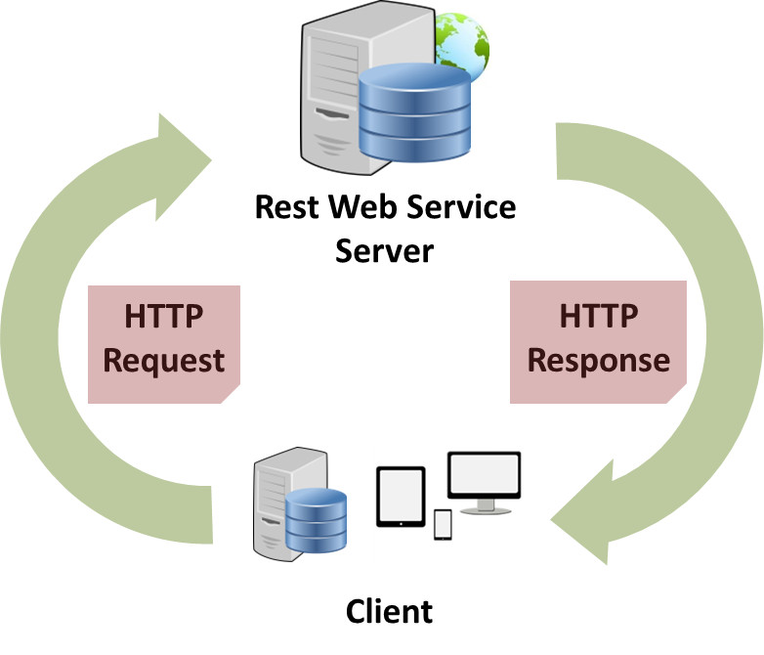
Web Programming Language
Front End → Client Side
HTML
Javascript
BackEnd → Server Side
Java
PHP
ASP.NET
Ruby (on Rails)
etc

Slide 5




Web Server
Apache HTTP Server (https://httpd.apache.org/)
Apache Tomcat (http://tomcat.apache.org/)
Internet Information Services (IIS) (http://iis.net/)
Nginx (http://nginx.org/)
etc

Slide 6



Apache + MySQL + PHP
Apache + MySQL + PHP Package
https://www.apachefriends.org/
http://www.wampserver.com/

Slide 7









Sistem Schema
User or Client on
Mobile Device
JSON

Slide 8
Test your Server
Test your server by opening the address http://localhost/ in your browser
Check phpmyadmin (front end of MySQL) by opening http://localhost/phpmyadmin

Slide 9
PHP Server Project
PHP: Hypertext Preprocessor
Location on → C:\xampp\htdocs\server
PHP Example (example.php) :
<?php
echo “Hello Android";
?>
Test on browser : http://localhost/server/example.php

Slide 10
example_query.php
<?php
mysql_connect("localhost","root","");
mysql_select_db("android_db");
$q=mysql_query("SELECT * FROM user");
while($row=mysql_fetch_assoc($q)) {
$json_output[]=$row;
}
echo json_encode($json_output);
?>

Slide 11

Result…
[
{
"username":"user",
"password":"pass“
}
]
[{"username":"user","password":"pass"}]

Slide 12
JSON (Java Script Object Notation) is a lightweight data-interchange format. It is easy for humans to read and write. It is easy for machines to parse and generate.

Slide 13
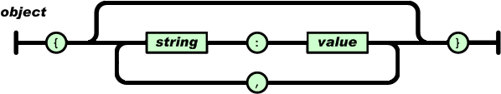
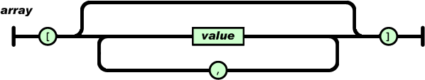

Slide 14
JSON Structure
An object is an unordered set of name/value pairs
The pairs are enclosed within braces, { }
There is a colon between the name and the value
Pairs are separated by commas
Example: { “PK”: “TEK”, “masa kuliah”: 3}
An array is an ordered collection of values
The values are enclosed within brackets, [ ]
Values are separated by commas
Example: [ “php”, “json”, “android” ]

Slide 15
JSON Example
{
"data":
[
{
"username":"user",
"password":"user"
}
]
}
echo '{"data":'.json_encode($json_output).'}';

Slide 16
How to get JSON from Server
HTTP request methods
GET
POST
JSON Parser example

Slide 17
Read JSON Format
Android has JSONArray, JSONObject class for parsing this format

Slide 18
Example #1
String json → [{"username":"user","password":"pass"}]
Android :
JSONArray jArray = new JSONArray(json);
for (int i = 0; i < jArray.length(); i++) {
JSONObject c = jArray.getJSONObject(i);
username = c.getString("username");
password = c.getString("password");
}

Slide 19
Example #2
String json →
{"data":[{"username":"user","password":"pass"}}
Android :
JSONObject jObject = new JSONObject(json);
JSONArray user = jObject.getJSONArray("data");
for (int i = 0; i < user.length(); i++) {
JSONObject c = user.getJSONObject(i);
username = c.getString("username");
password = c.getString("password");
}

Slide 20
Exercise
{
"phoneNumber": [
{
"type": "phone",
"num": "(0251)12345"
},
{
"type": "fax",
"num": "(0251)54321"
}
],
"address": {
"address": "jalan kumbang 14",
"city": "Bogor"
},
"name": "Diploma IPB"
}

Slide 21
Android Manifest
Uses-Permission
android.permission.INTERNET

Slide 22
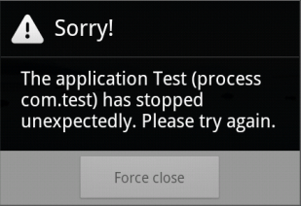

Slide 23
Thank you
Andika Sundawijaya
sundawijaya@gmail.com
Teknik Komputer & Manajemen Informatika
Program Diploma IPB

